Slide 1
AI IN PROD- Premalatha T

Slide 2

WHO AM I?
LinkedIn: https://www.linkedin.com/in/latha-t-k-b21018128/
Data Science ,AIML
Data Analysis ,SQL,Pyspark
Data Visualization ,PowerBI,Tableau
Natural Language Processing (NLP)
Computer Vision
Generative AI,Prompt Engineering
BigData and Data Engineering

Slide 3
Agenda
Types of Analytics
Steps in a ML Project
Supervised and Unsupervised Learning
Regression and Classification

Slide 4
Data?
Information + Noise
Information(useful)
75% ->Try to get 100%
Possible? NO

Slide 5
Types of Analytics
In today's data-driven world, information is king. But raw data itself isn't enough.
We need to analyze it to extract insights and make informed decisions

Slide 6
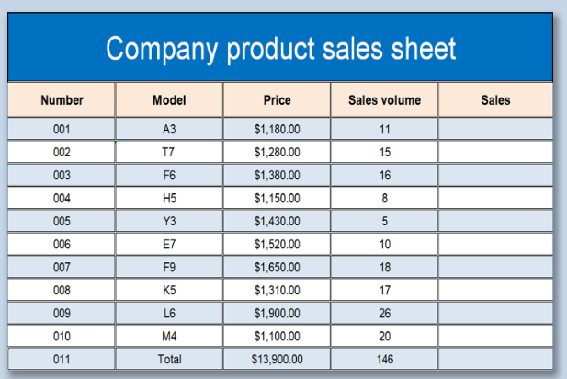
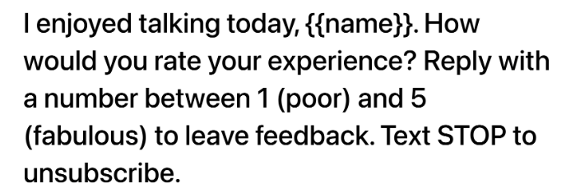

Slide 7
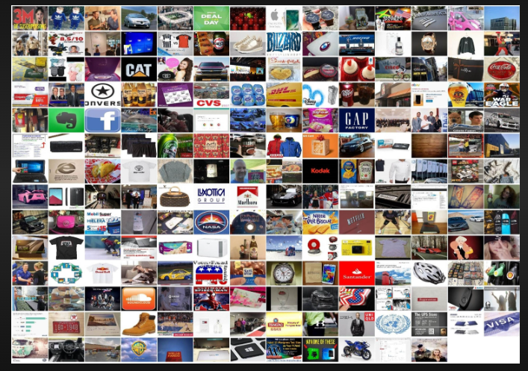
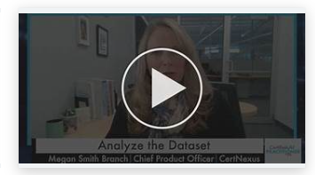
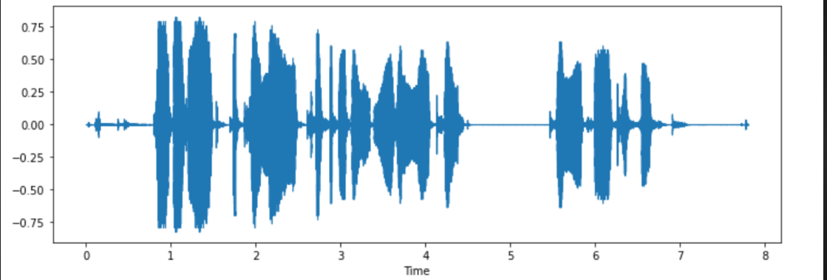

Slide 8
Check!!!
Is the data organized into rows and columns?
Does the data follow a consistent format throughout?
Can the data be easily queried using a structured query language (SQL) or similar?
Does the data lack a predefined structure or format?
Is the data primarily composed of free-form text or multimedia content?
Is the organization of the data irregular or unpredictable?

Slide 9






Slide 10
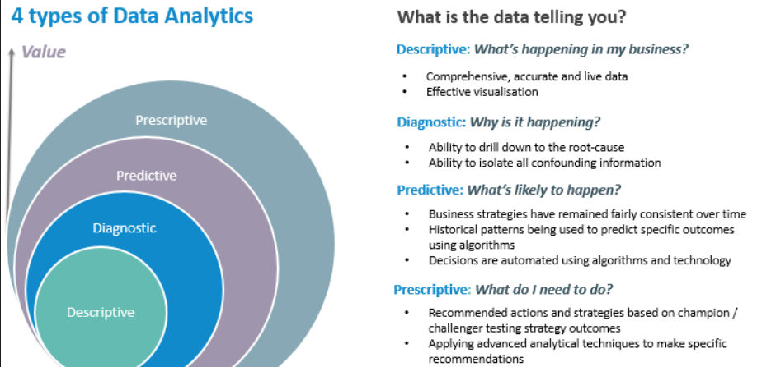

Slide 11
Scenario
TechTrendz is a leading retailer specializing in electronics and gadgets. Over the years, the company has accumulated vast amounts of data related to sales, customer behavior, inventory, and marketing campaigns. Let's follow TechTrendz through their analytics journey.

Slide 12
Analytics?
TechTrendz's analytics team starts by analyzing sales data from the previous year.
They create reports and dashboards to visualize key performance indicators (KPIs) such as total revenue, sales by product category, and geographical sales distribution.
Through descriptive analytics, they gain insights into which products are top sellers, peak sales periods, and popular customer demographics.

Slide 13
Analytics?
After identifying a decline in sales for a particular product line, TechTrendz's analysts dive deeper into the data.
They perform root cause analysis to understand the factors contributing to the decline.
Through diagnostic analytics, they uncover issues such as pricing competitiveness, insufficient marketing efforts, or changes in consumer preferences, enabling them to formulate corrective actions.

Slide 14
Analytics?
Armed with insights from descriptive and diagnostic analytics, TechTrendz's team leverages predictive analytics to forecast sales for the upcoming quarter.
By analyzing historical sales trends, seasonality, economic indicators, and market trends, they develop predictive models to anticipate demand for various products.
These forecasts help the company optimize inventory management, pricing strategies, and resource allocation.

Slide 15
Analytics?
With predictive models in place, TechTrendz's executives turn to prescriptive analytics to determine the best course of action.
Using optimization algorithms, they simulate different scenarios to maximize profitability, minimize costs, or optimize marketing ROI.
For example, they may use prescriptive analytics to decide on promotional strategies, inventory replenishment schedules, or pricing adjustments, ultimately driving business growth and competitiveness.

Slide 16
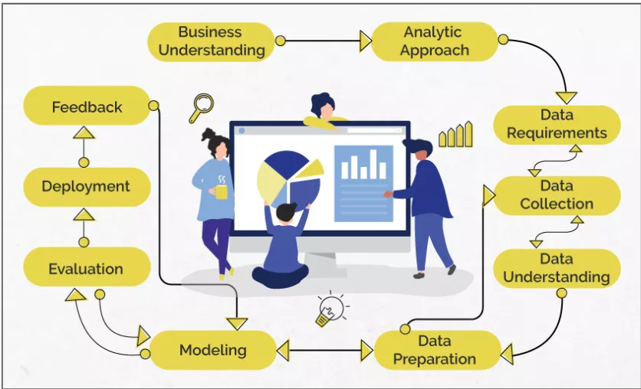
Data Science/Machine Learning

Slide 17
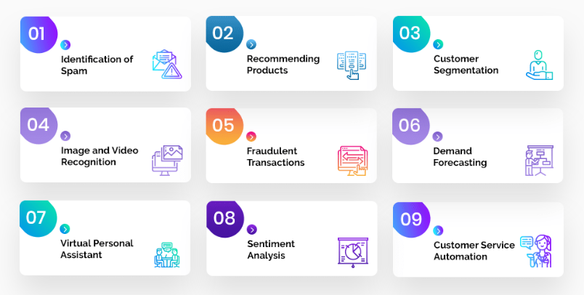
Problem Statement

Slide 18
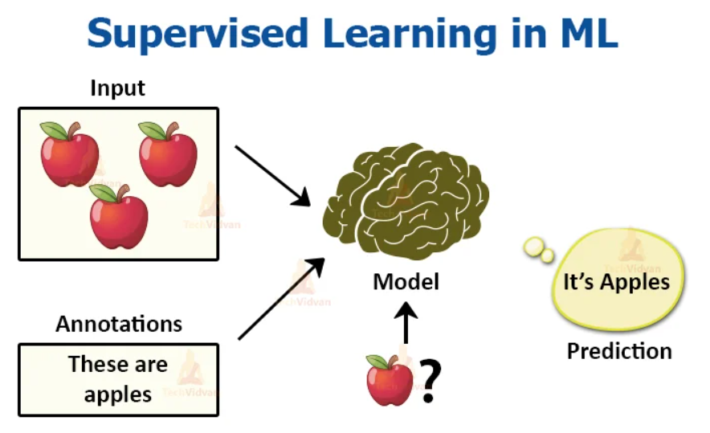
Analytic Approach

Slide 19
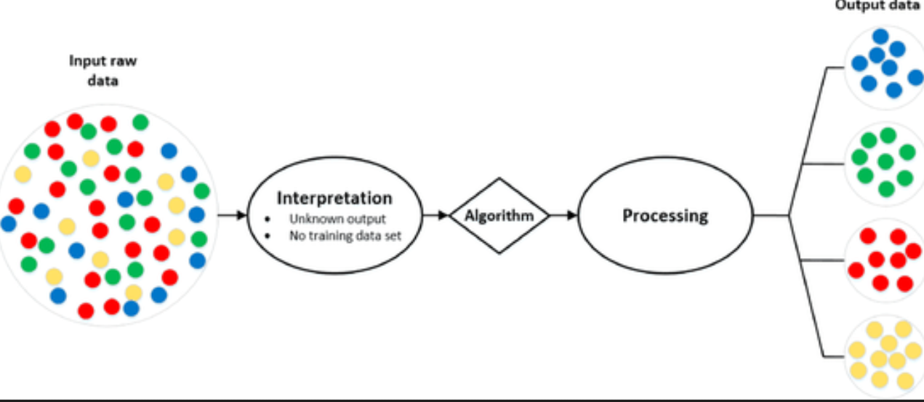
Analytic Approach

Slide 20
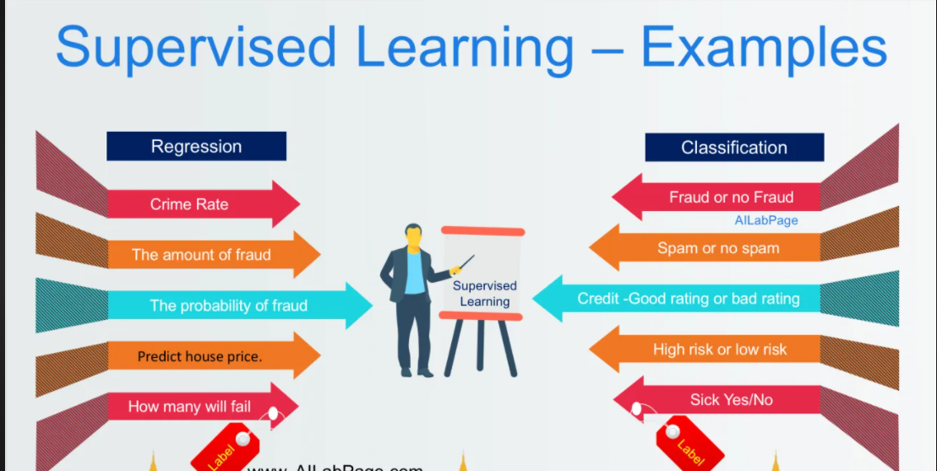
Supervised Learning

Slide 21
Machine Learning
Supervised Learning
Unsupervised Learning

Slide 22
Data understanding
Qualitative
Quantitative
Discrete
Continuous
Categorical
Ordinal

Slide 23
Data preparation
Missing Values
Outliers
Handling Categorical variables
Redundancy in data

Slide 24
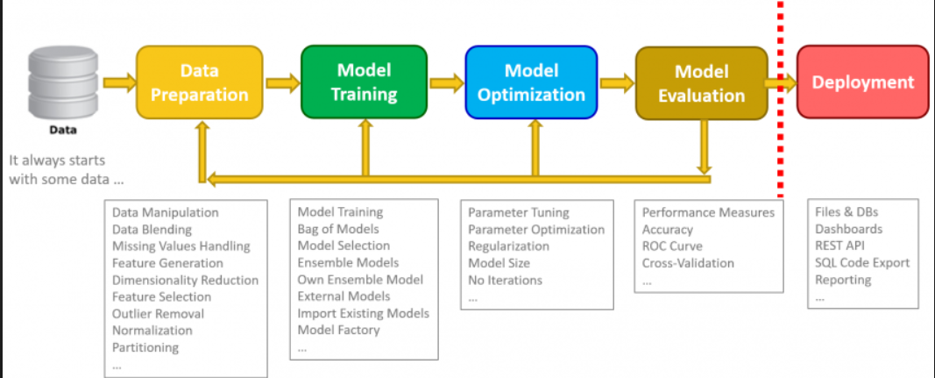
Data Science

Slide 25
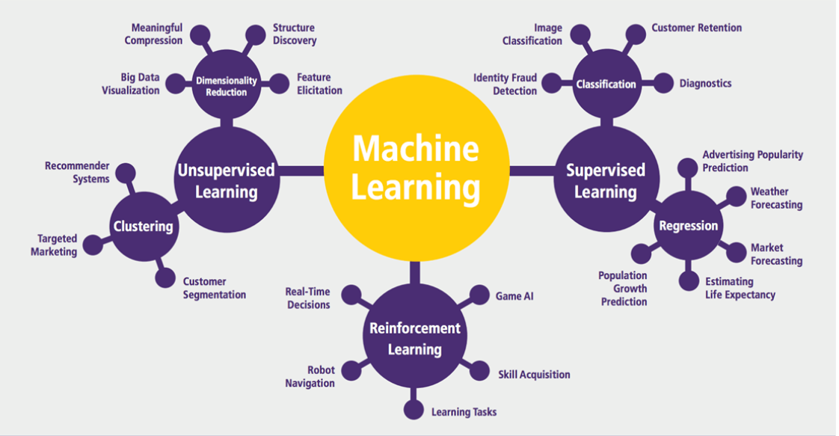
Machine Learning

Slide 26
Applications in Manufacturing
Price Optimization
Predictive Analytics
Demand Forecasting and Inventory Management
Supply Chain Management

Slide 27
Applications in Retail and E-Commerce
Market Basket Analysis
Warranty analytics
Price Optimization
Inventory Management
Location of new stores
Customer sentiment analysis

Slide 28
Applications in Education
Improve Adaptive Learning
Better Assessment of Teachers
Improve Student’s Performance
Better Parent Involvement

Slide 29
Other Applications
Agriculture
Customer Service
Airline Route Planning
Product Recommendation Systems
Digital marketing and Advertising
Internet Search

Slide 30
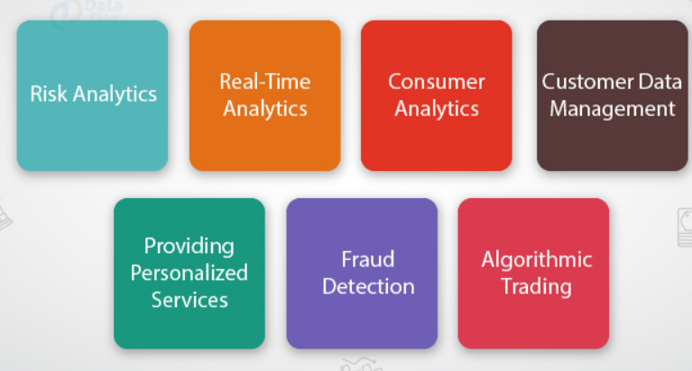
Applications in Finance

Slide 31
Career opportunities
Business Intelligence Analyst
Data Analyst
Data Scientist
Data Engineer
Quantitative Analyst
Data Analytics Consultant
Operations Analyst
Marketing Analyst
Transportation Logistics Specialist
Big data Engineer
Artificial Intelligence researcher
Machine Learning Engineer
Research Scientist
AI Data Analyst
AI Engineer
Robotics Scientist

Slide 32
Questions ????

